Slide 1

Book Recommendation Chatbot using IBM Watson Assistant
Developed by Khushi Singh, this project leverages IBM Watson Assistant to create an intuitive chatbot that revolutionizes book discovery through natural language conversations.

Slide 2
Declaration and Acknowledgement
I, Khushi Singh, declare that this project, "Book Recommendation Chatbot using IBM Watson Assistant," is my original work. All concepts and code implementations are a result of my dedicated effort during the PBEL Virtual Internship.
I extend my sincere gratitude to Mr. R Devnath for his invaluable guidance and mentorship throughout this project. I also thank the IBM PBEL team for providing this incredible learning opportunity and my college, United College of Engineering And Research, for their support.

Slide 3
Table of Contents
Introduction to the Book Recommendation Chatbot
Core Technologies Involved in Development
Overcoming Development Challenges and Solutions
Key Features and Dialog Flow Architecture
Seamless Website Integration and Deployment
Project Output Screenshots
Summary and Future Enhancements

Slide 4
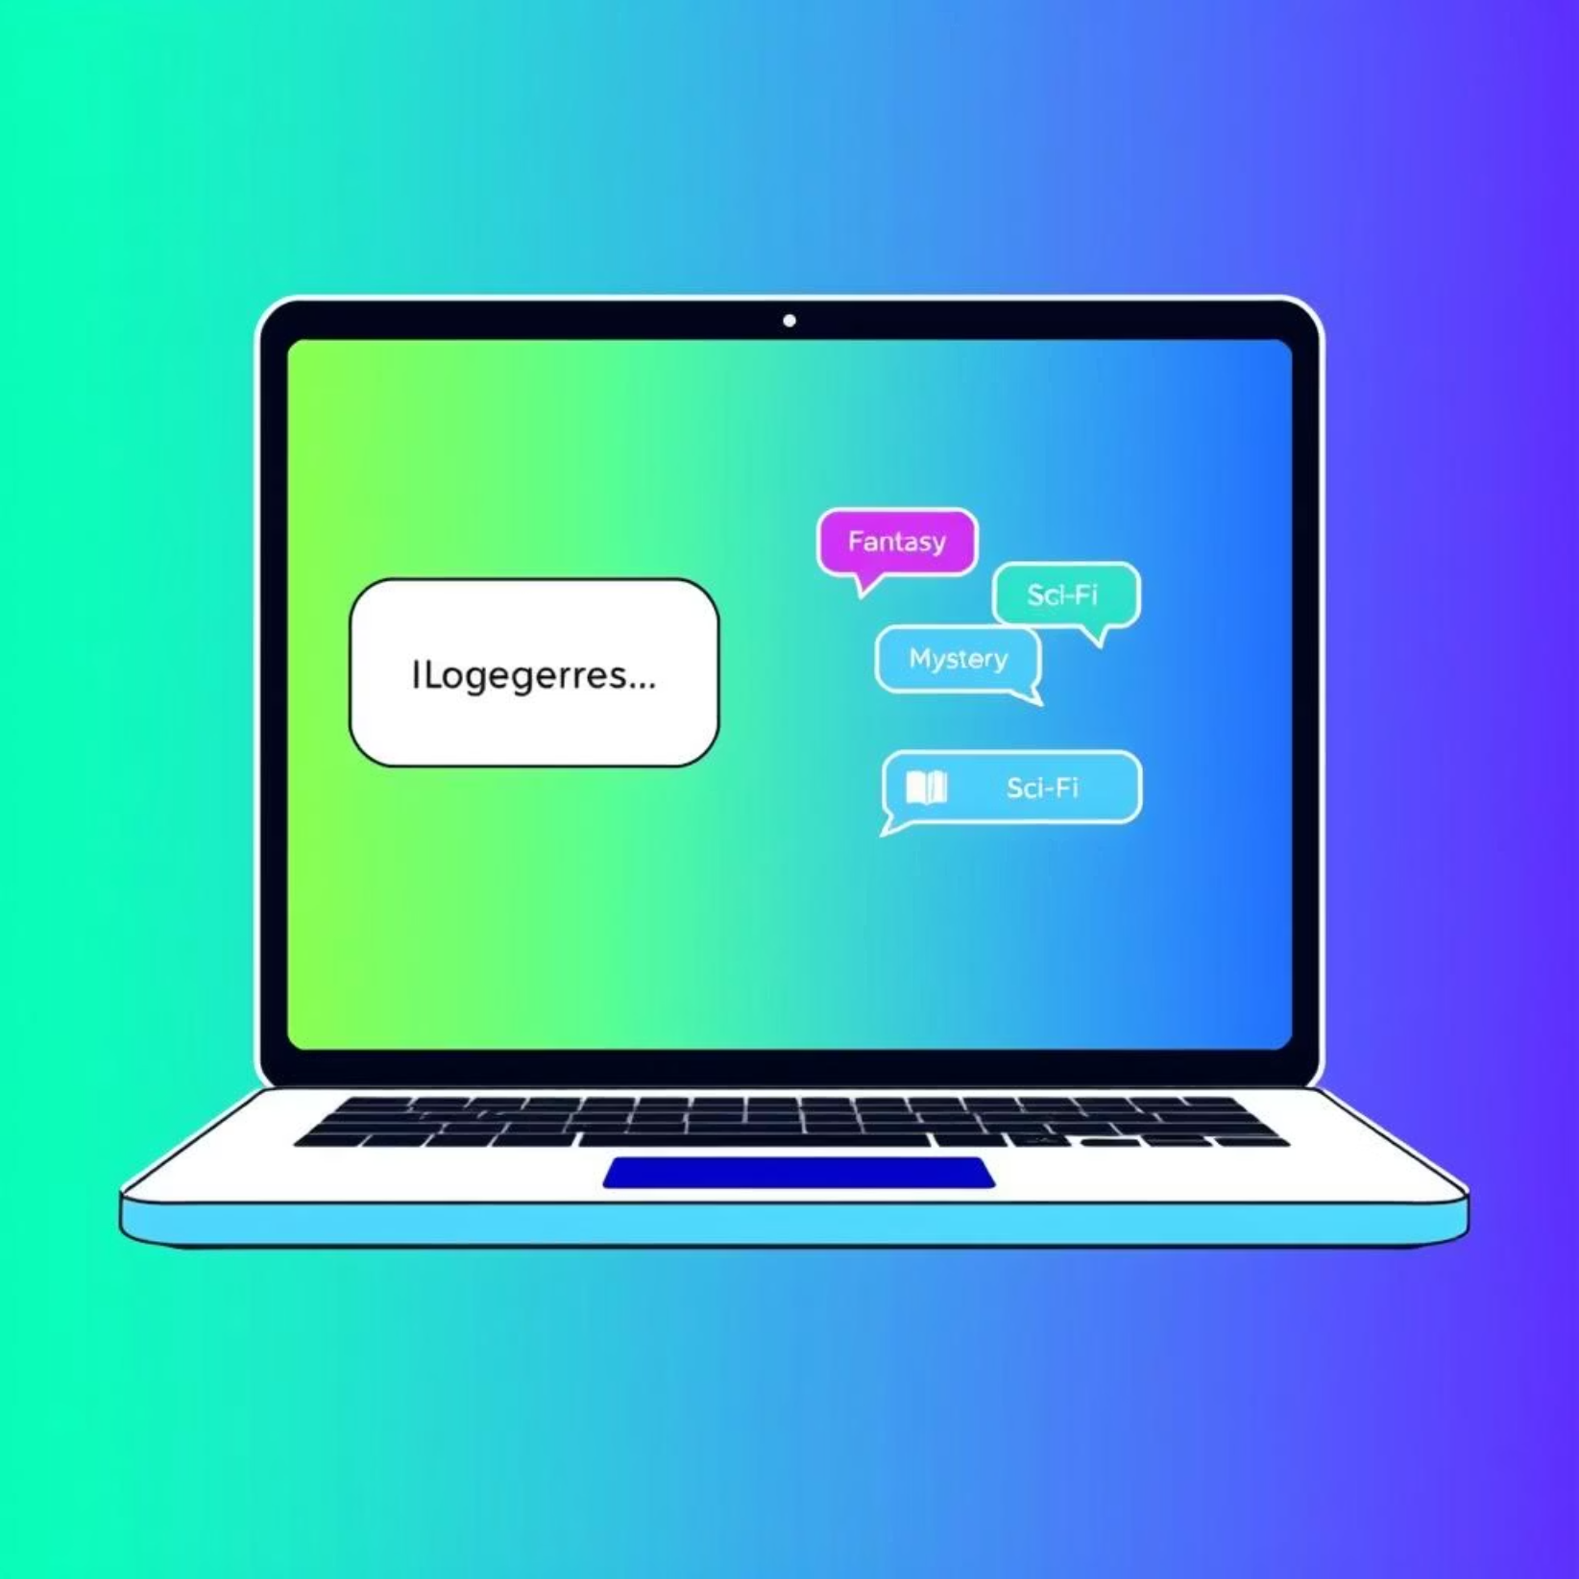
Project Overview: A Genre-Based Recommender
The Book Recommendation Chatbot, built with IBM Watson Assistant, offers users a streamlined way to discover books. It suggests titles based on specified genres, such as fantasy, mystery, or sci-fi, enhancing the user experience through natural language interaction.
Purpose: To facilitate book discovery.
Method: Genre-based recommendations.
Interface: Natural language conversation.

Slide 5




Key Features and Core Technologies
Our chatbot leverages several IBM Watson Assistant functionalities to deliver a robust and user-friendly experience.
Genre-Based Recommendations
Intents Recognition
Utilizes the @genre entity to identify and suggest books from specific categories.
Detects user intentions such as greet, recommend_book, and thanks for seamless flow.
Robust Fallback Handling
Easy Web Integration
Manages unrecognized inputs gracefully, ensuring a smooth user experience even for out-of-scope queries.
Facilitates quick deployment via Watson Web Chat, simplifying integration into any website.

Slide 6





Understanding the Dialog Flow
The chatbot's conversational logic is structured to guide users efficiently from inquiry to recommendation.
User Greeting
Detect Genre
Book Suggestions
Fallback Response
This sequential flow ensures that user interactions are always met with an appropriate and helpful response.

Slide 7

Seamless Website Integration
Integrating the Book Recommendation Chatbot into any website is straightforward, requiring minimal setup and no complex backend development.
Simple Script Tag: Watson Assistant Web Chat is embedded using a single script tag in the website's HTML.
Front-End Placement: The chatbot widget conveniently appears in the bottom-right corner of the web page.
Browser-Based Operation: The entire chatbot functionality runs directly in the user's browser, eliminating the need for server-side code.

Slide 8
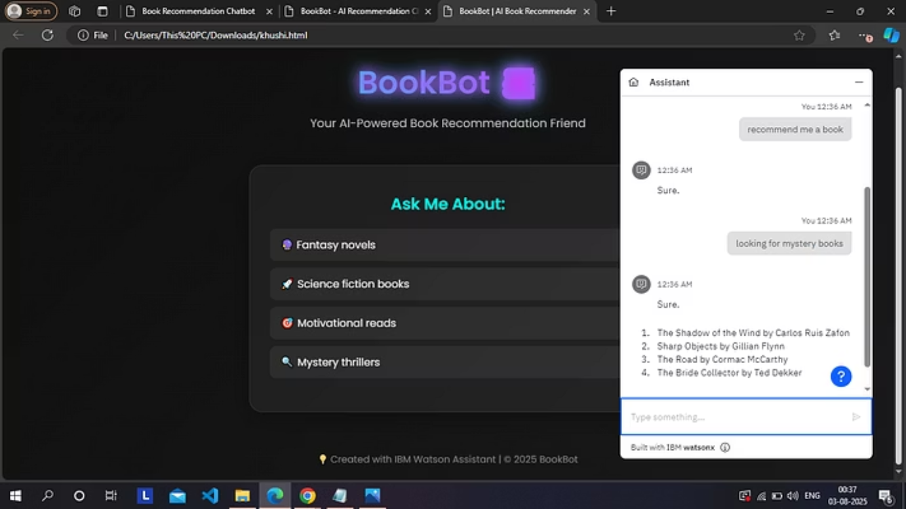
Project Output: Chatbot in Action
Here are clear screenshots demonstrating the chatbot's interface and its ability to provide genre-based book recommendations.
These visuals highlight the user-friendly interface and the direct display of book suggestions within the chat window.

Slide 9



Conclusion and Future Scope
This project successfully demonstrates the potential of IBM Watson Assistant for creating effective and easily deployable conversational AI solutions.
Simple & Effective
Rapid Deployment
Future Enhancements
A straightforward chatbot focused purely on genre-based recommendations.
Built with IBM Watson Assistant for quick and effortless integration.
Can be expanded to include user ratings, author-based suggestions, or personalized recommendations.

